Slide 1

Income Prediction with
Adult Cencus Income Datasets from UCI Machine Learning
This data was extracted from the 1994 Census bureau database by Ronny Kohavi and Barry Becker (Data Mining and Visualization, Silicon Graphics). A set of reasonably clean records was extracted using the following conditions: ((AAGE>16) && (AGI>100) && (AFNLWGT>1) && (HRSWK>0)). The prediction task is to determine whether a person makes over $50K a year.
Source : https://www.kaggle.com/uciml/adult-census-income/kernels

Slide 2

Knowing your customer income level is so importance
Beside knowing your customer’s demoghrapics, one of the key to build the business is knowing about how much money they have in current area.

Slide 3


Make a right decision
Some business can bankrupt if they don’t know the average annual income in current area.
Big company used to analyze their prospective customers.

Slide 4
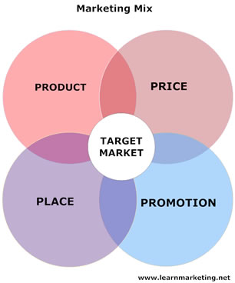
How model machine learning impact on Business?
Businesses of all sizes in all industries need to market their products and services to their target audience. You will find that effectively marketing your product or service is the best way to catch the attention of your consumers and increase sales.
One of the fundamental principles of marketing involves understanding the problems of your consumer.
Can machine learning answer this?

Slide 5
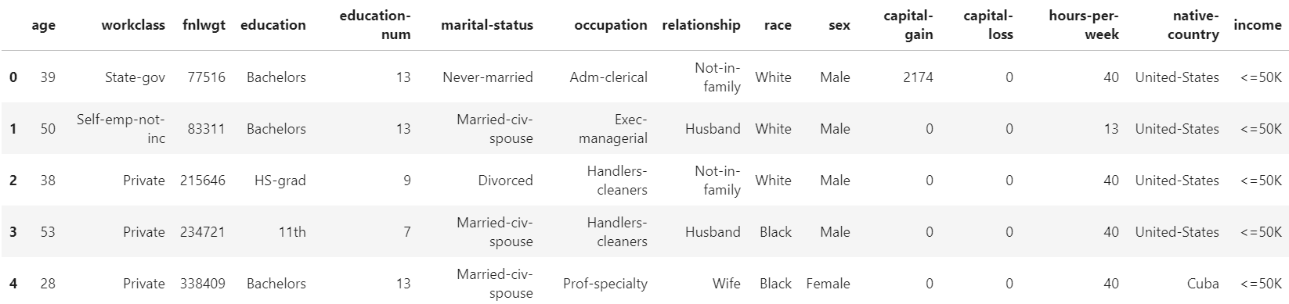
How to predict it ?
With Adult Census Income, we can predict whether they have less than 50K us dollar a year or not. Machine learning can help people to classify income in current area based on this datasets.
This some examples from this data

Slide 6
Income
The target in datasets explain having annual income less than 50K and more than 50K. We can look at diagram pie chart that people with income less than 50K is higher than with more than 50K.

